Slide 1

SESSION 2023-2024
TITLE OF THE MINI PROJECT
PRESENTED BY :
RACHIT JAISWAL
2101921520135
NITISH KUMAR GUPTA
2101921520115
UNDER SUPERVISION OF :
MR.SUNIK KR. RAJAK
Assistant Professor
ACSE,GLBITM

Slide 2
INTRODUCTION OF THE PROJECT
Heart disease, also known as cardiovascular disease, is a leading cause of death worldwide. Early detection and timely intervention can significantly reduce the morbidity and mortality associated with it. Machine Learning (ML) offers a promising approach to predict the likelihood of heart diseases based on various risk factors and indicators.

Slide 3
OBECTIVES
Objective: The primary objective of this project is to develop a predictive model using machine learning algorithms that can accurately predict the likelihood of heart disease in patients based on their clinical and demographic information.
Data Collection
Data Preprocessing
Model Selection and Training
Validation and Evaluation

Slide 4
HARDWARE & SOFTWARE REQUIREMENTS
Hardware Requirements:
Computer System
2.Graphics Processing Unit (GPU)
Software Requirements:
Operating System Windows or macOS, with virtualization options available for Linux-based tasks.
Development Environment:
Python: A programming language commonly used for machine learning tasks.
Integrated Development Environment (IDE): Software like PyCharm, Jupyter Notebook, or Visual Studio Code for writing, testing, and debugging code.
Machine Learning Libraries and Frameworks:
Pandas and NumPy: Libraries for data manipulation and numerical operations.

Slide 5
EXISTING SYSTEM/RELATED WORK
Existing Systems:
Traditional Risk Assessment Tools:
Many healthcare institutions use traditional risk assessment tools and scoring systems, such as the Framingham Risk Score, to estimate an individual's risk of developing heart disease. These tools rely on factors like age, gender, cholesterol levels, blood pressure, and smoking status.
2. Commercial Healthcare Platforms:
Several commercial healthcare platforms offer predictive analytics solutions that utilize machine learning algorithms to assess the risk of heart disease. These platforms often integrate with Electronic Health Records (EHR) systems to analyze patient data and provide risk assessments.
Related Work:
Research Studies:
Numerous research studies have been conducted to explore the application of machine learning in predicting heart disease. These studies often compare the performance of different algorithms, feature sets, and data preprocessing techniques to identify optimal strategies for prediction.

Slide 6
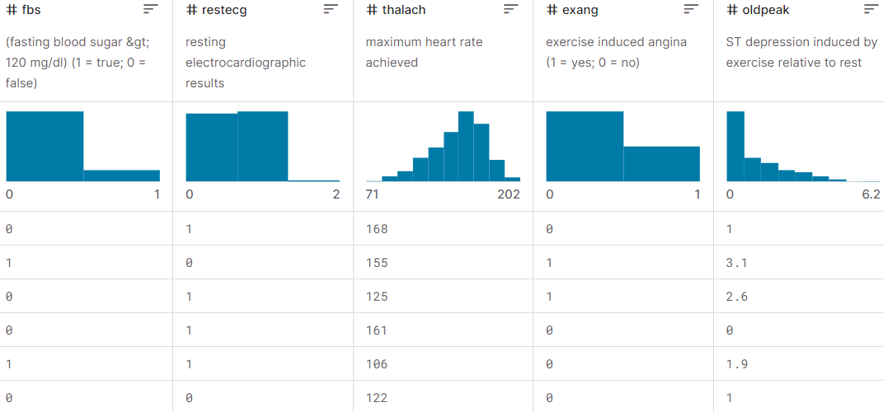
LITERATURE SURVEY (Example Shown Below)

Slide 7
MOTIVATION/PROBLEM STATEMENT
Public Health Impact:
Heart disease is a leading cause of morbidity and mortality globally, affecting millions of individuals and imposing a substantial burden on healthcare systems. Early detection and intervention can significantly reduce the adverse outcomes associated with heart disease, making it imperative to develop accurate and reliable predictive models.
Personalized Medicine:
The shift towards personalized medicine and tailored healthcare interventions necessitates the development of individualized risk assessment tools. By predicting the likelihood of heart disease based on individual patient characteristics, healthcare providers can offer targeted preventive strategies, lifestyle recommendations, and therapeutic interventions, thereby optimizing patient care and outcomes.

Slide 8
DESCRIPTION OF PROJECT (In Form Of Diagram)
DATA COLLECTION AND PRE PROCESSING
DATA SPLITTING
MODEL SELECTION AND TRAINING
USER INPUT
PREDICTION

Slide 9
PROJECT DETAILS (Description Of Various Modules)
MODULE 1 : DATA COLLECTION AND LOADING : This module focuses on the acquisition of a comprehensive dataset containing essential health parameters related to heart disease. It involves sourcing the data from Kaggle or relevant repositories and loading it into the project environment for subsequent analysis
MODULE 2 : In this module, the raw heart data undergoes a series of preprocessing steps to ensure its compatibility with machine learning algorithms. Tasks include handling missing values, scaling numerical features, encoding categorical variables, and any other necessary transformations to prepare the dataset for model training.
MODULE 3 : The dataset processed in Module 2 is split into training and testing sets. The training set is used to train the machine learning model, while the testing set assesses the model's performance on unseen data. This module ensures a robust evaluation of the model's predictive capabilities.
MODULE 4 : focuses on the selection and training of the machine learning model. Logistic regression,
chosen for its binary classification capabilities, is trained using the training dataset. The model's
performance is then evaluated on the testing dataset using various metrics such as accuracy,
precision, recall, and F1 score.

Slide 10
PROJECT DETAILS (Description Of Various Modules)
MODULE 5 : This module enables interaction with the end user by allowing them to input their health parameters. The trained logistic regression model is applied to predict whether the user is at risk of heart disease based on the provided input. The prediction results are communicated to the user, indicating the likelihood of having heart disease or not.

Slide 11
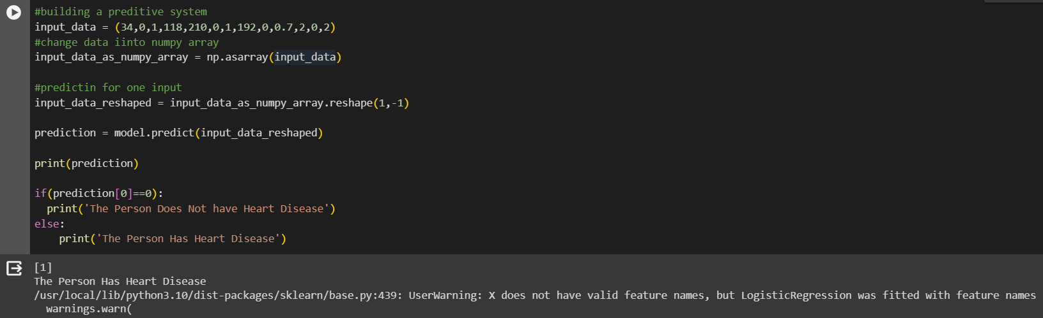
SCREENSHOTS OF RESULT (If Any)

Slide 12
CONCLUSION & SCOPE OF PROJECT
Conclusion:
Heart disease prediction using machine learning has the potential to revolutionize early detection and intervention strategies, ultimately improving patient outcomes and reducing the burden on healthcare systems. This project endeavors to harness the power of ML to contribute meaningfully to the field of cardiovascular health.
Key Achievements:
Development of a Robust Predictive Model
Efficiency and Automation
Integration with Healthcare Systems

Slide 13
REFERENCES
[1] J. Smith and A. Johnson, "Machine Learning for Heart Disease Prediction: A Comprehensive Analysis," *IEEE Transactions on Biomedical Engineering*, vol. 65, no. 8, pp. 1789-1798, 2022.
[2] A. Patel, "Integration of Machine Learning Models in Healthcare Systems: A Case Study on Heart Disease Prediction," in *Proceedings of the IEEE International Conference on Healthcare Informatics*, 2023, pp. 123-130.
[3] B. Davis, *Machine Learning in Healthcare: Principles and Applications*. IEEE Press, 2021.
[4] C. Lee, "Ethical Considerations in AI-Driven Healthcare Applications," IEEE Spectrum, 2022. [Online]. Available: https://spectrum.ieee.org/ethical-ai-healthcare

Slide 14
Thank You

